Slide 1
Getting equality right for all
Janice Stevenson, LGBT Youth & Michelle Ritchie, Police Scotland

Slide 2
Victim Support Scotland Conference LGBT Experiences
Janice Stevenson: Development Officer
@Janice_LGBTYS or @LGBTYS

Slide 3
LGBT Youth Scotland is the largest youth and community-based organisation for lesbian, gay, bisexual and transgender (LGBT) people in Scotland.
Working with young people aged 13-25, our mission is to play a leading role in the provision of quality youth work to LGBTI young people that promotes their health and wellbeing, and to be a valued and influential partner in LGBTI equality and human rights.

Slide 4
Youth Groups
1-2-1 coaching
Digital youth work service
Partnerships
Youth Participation projects
Influencing
Capacity Building
Policy and research

Slide 5
LGBT Experiences
Hate Crime

Slide 6
Life in Scotland 2017
79% of LGBT young people said that homophobia was a problem for Scotland.
74% felt that biphobia was a problem.
85% thought that transphobia was a problem.

Slide 7
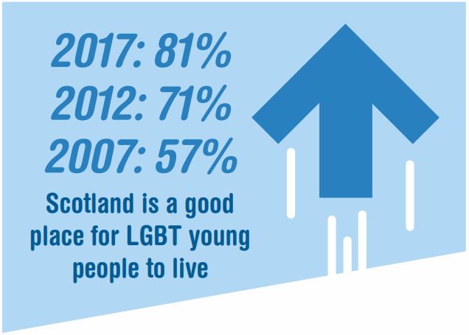
53% of LGBT young people said that their local area is a good place to live, which is similar to 2012 findings.
50% of transgender respondents said that their local area is a good place to live, an increase from 37% in 2012.
Notes:
Lesbians:
Ellen Degeneres
Sue Perkins
Carol Ann Duffy Jackie Kay
Martine Navratilova
Casey Stoney – English Footballer

Slide 8
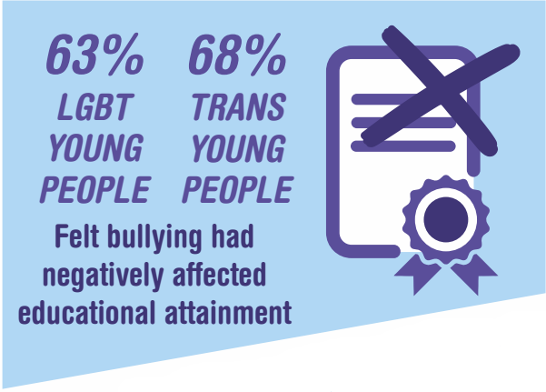
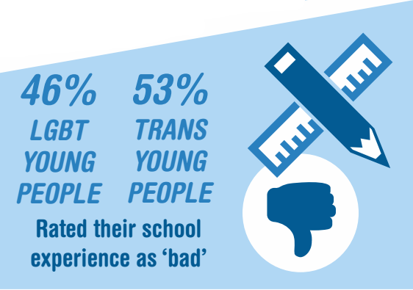
Education
71% of LGBT young people experienced bullying in school on the grounds of being LGBT. This is a rise from 69% in 2012 and 60% in 2007.
82% of transgender young people experienced bullying in school, an increase from 77% in 2012.
Notes:
Lesbians:
Ellen Degeneres
Sue Perkins
Carol Ann Duffy Jackie Kay
Martine Navratilova
Casey Stoney – English Footballer

Slide 9
Rights and Hate Crime
48% of LGBT young people and 58% of transgender young people were aware of their rights under hate crime legislation.
35% of LGBT young people said that they had experienced a hate crime or incident in the past year. Transgender young people were slightly more likely (41%), and non-binary young people were the most likely (51%)

Slide 10
LGBT Experiences
Domestic Abuse

Slide 11
LGBT Domestic Abuse
Domestic Abuse and Risks
1 in 4 LGBT people will experience domestic abuse, the same rate as for heterosexual women (Henderson 2003).
80% of transgender people experience some form of abusive behaviour from a partner or ex-partner.
73% of respondents had experienced specifically transphobic abuse
Lack of recognition of domestic abuse in LGBT relationships
More likely to experience domestic abuse in first relationship
Significant barriers to reporting and seeking support

Slide 12
Barriers
To Seeking Support
And Reporting

Slide 13
Barriers to Accessing Support
Real or perceived homophobia from service providers
The need to ‘out’ oneself to access services and concerns about subsequent referrals
Impact of internalised homophobia , biphobia or transphobia
Stereotyping around LGBT people
Lack of appropriate or specialist services
Lack of training in relation to LGBT Domestic Abuse, including failure to screen for alleged perpetrator and victim
Lack of confidence in criminal justice system

Slide 14
Barriers to Reporting
Minimising of experiences- ‘It wasn’t that bad’
Real or perceived homophobia, biphobia and transphobia in services
People not aware they can report or how to report
Fear of not being taken seriously or not being believed
Fear of having to out oneself in the reporting process
Fear of being outed in courts
Lack of awareness of protections available
Fear of Police and criminal justice systems

Slide 15
Inclusive Services
The LGBT Charter Mark

Slide 16
An Accessible Service
Never make assumptions about sexual orientation or gender identity
Ensure you have training and resources
Consider how you can address the unique barriers faced by LGBT people
Acknowledge and respond to concerns about the risk of discrimination from other services and/ or professionals
Have clear links with other organisations and be able to make referrals
Ensure visibility of LGBT people in services and be explicit about services offered to LGBT people

Slide 17
The LGBT Charter makes a clear statement that equality and diversity are at the heart of your organisation.
The Award lasts for 4 years.
Notes:
External facing

Slide 18
What is The LGBT Charter?
The LGBT Charter is a straightforward programme that enables your organisation to proactively include LGBT people in every aspect of your work;
supporting staff and Volunteers
providing a high quality service to members, customers and service users

Slide 19
Why do the Charter?
The LGBT Charter will improve your organisation’s knowledge and confidence to challenge prejudice and proactively create an inclusive environment where LGBT people are valued.
Notes:
Internal benefit

Slide 20
What’s Involved?
Training – LGBT awareness training is delivered to a percentage of your staff team dependent on the award you are working towards
Policy – review and update relevant policies with a particular focus on the Equality Act 2010, and undertake impact assessments
Practice – engage with the LGBT cultural calendar and LGBT communities in your area

Slide 21
What’s Involved?
Promotional Material and Resources – promote your LGBT Charter journey and make sure relevant resources are inclusive
Monitoring and Evaluation – have processes in place to monitor your progress and consult with LGBT staff, partners, customers or service users
Evidence – Submit your evidence portfolio for review
Additional evidence
Certificate Awarded

Slide 22
Questions?

Slide 23
lgbtyouth.org.uk
Janice.Stevenson@lgbtyouth.org.uk

Slide 24
Victim Support Scotland
Conference 2019
Inspector Michelle Ritchie

Slide 25
Safer Communities
Business area of Partnerships, Prevention and Community Wellbeing.
Predominately deal with Crime Prevention.
Protect those most vulnerable at risk of harm.
Make our communities safer places to live, work and visit.

Slide 26
Equality & Diversity Unit
Engage directly with national equality groups, SG and organisations who support people from all our communities.
Provide advice, guidance and support to police officers and staff.
Individual Officers have differing portfolios.

Slide 27
Some of our work
Hate Crime Champions - internal
Hate Crime Awareness – external
Third Party Reporting
Campaigns

Slide 28
Hate Crime 2018-2019
Disability – 217 4%
Race – 3388 65%
Religion – 384 7%
Sexual Orientation – 1002 19%
Transgender Identity – 68 1%
Multiple Aggravators – 191 4%
Key Findings
67% racist
45% s38
23% s50A(1)B
UNDER-REPORTING STILL A MAJOR CONCERN

Slide 29
Why are Hate Crimes different?
Very often offenders are not motivated by hatred for their victim, but rather it’s their expression of hatred against the victim’s (presumed) group membership that characterises hate crimes.
A mechanism of power and oppression intended to reaffirm hierarchies of social order.
Hate crimes are designed to convey a message to this community that they are somehow different and don’t belong.
Can be very personal and specifically targeted.
Impact on victim and communities.
NEVER TREAT IN ISOLATION
HATE CRIMES TEND TO ESCALATE

Slide 30
Next Steps
We will continue to improve at recognising and dealing with hate crime.
We will continue to work with organisations, groups and individuals to raise awareness of, and break down barriers to reporting hate crime.
We have to get better at understanding the unique needs of victims of hate crime and ensure they can access effective support.
We cannot do any of this alone!!

Slide 31
Contact Details
Michelle.ritchie@scotland.pnn.police.uk
Diversityunit@scotland.pnn.police.uk
SCDEdinburghdiversityunit@scotland.pnn.police.uk

