Slide 1
Scotland’s child victims and witnesses
Mary Glasgow, CEO Children 1st

Slide 3
Great Partnerships
Children 1st and VSS
Mary Glasgow
Chief Executive
Children 1st

Slide 4
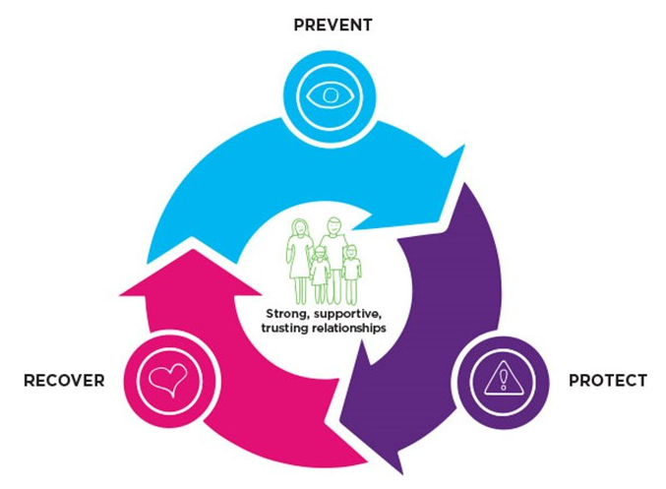
The cycle of hope
Notes:
Children 1st – what we do and why we are different

Slide 5
Our transformative vision
By 2023, our vision is that children in Scotland will be safer, will grow up in strong, resilient families and will have access to early help and support when they need it.
They will have their rights protected in all areas of their lives.
Prevention of harm to children, stronger, more resilient families and communities, greater respect for children’s rights and strong partnerships and community engagement will be our measures of success.
Notes:
Not about me, not at about Children 1st, but about transforming the lives of every child in scotland

Slide 6
Partnerships
– what makes them work
Notes:
The best partnership aren't where you do the same thing – it where you have complimentary strengths and can support each other to achieve a shared goal

Slide 7
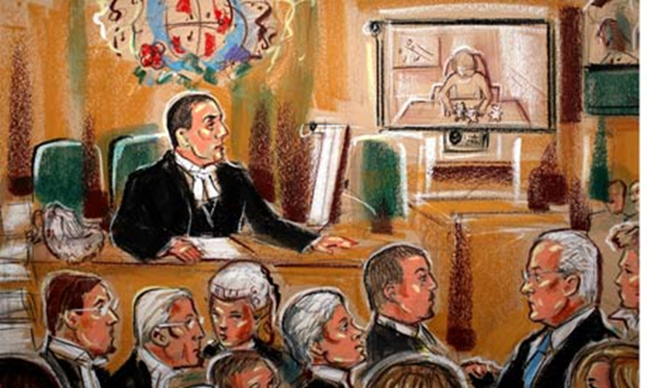
Why we are proud to be
partners of
Victim Support Scotland
Notes:
We know all to often needs of child victims of crime are not properly taken into account. For some children court – police – lawyers can be nearly as traumatising as the crime itself
Progress – victims taskforce, 2014 act and 2019 act – but still trying to bolt on support for a system that doesn’t understand

Slide 8
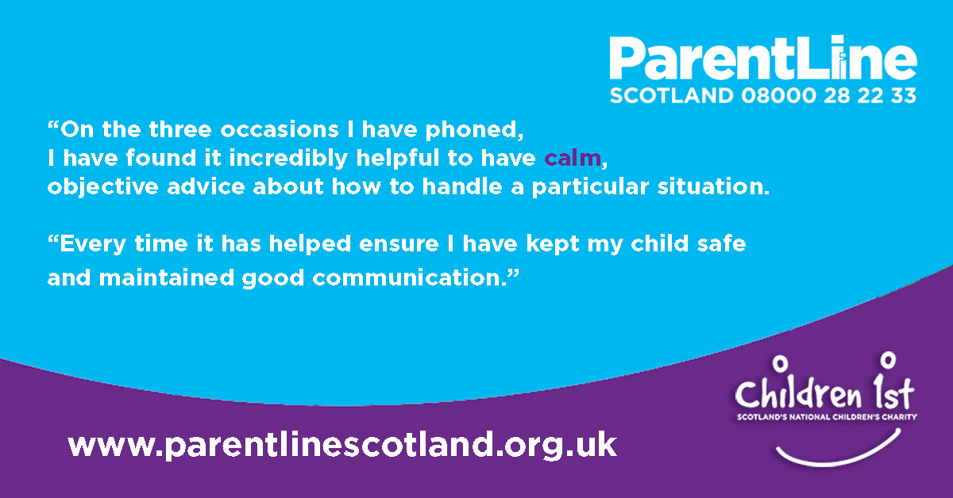
Our helplines
Notes:
Eaxmple of joint work from August this year and is fairly typical - VSS supported the family through the criminal process and Parentline supported the parent in addressing the impact on the child
Parentline recived a Victim Support referral for a family who were subject to a breaking and entry – the would-be ‘burglar’ had smashed a window to gain entry and climbed through into what was the bedroom of two young children. Although the individual left immediately the wee girl in particular was traumatised by this, and Mum felt she needed professional support. The family were living with relatives whilst forensics were being carried out, and the Mother suspected her ex was responsible for the B&E.
The mother didn’t need support with dealing with the justice process (VSS were providing this) but was keen to talk through with one of our fantastic parentline volunteers ways she might go about ‘normalising’ the child’s day to day routine, reassuring her and helping the child to process the experience in her own way, Parentline then sign-posted the child to ChildLine.

Slide 9
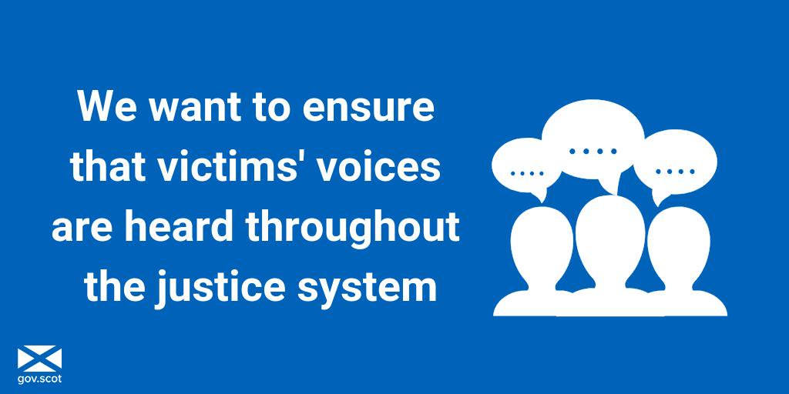
Campaigning together
Notes:
Increasing work together through the Victims Of Crime Forum for Scotland – Shocked to hear recently that we understand that less than 12% of victims of crime in Scotland who are invited to make a Victim Impact Statement, so the impact on them can be considered in sentencing actually make a statement. But then when I learnt about the archaic rules – al statements must be written out in longhand, with no online version – I wasn’t surprised to hear the numbers were so low. That’s the kind of thing we can and will change by working together.

Slide 10
A shared agenda for the future – challenges (child) victims face
Notes:
Sherriff courts like this are designed to intimidate –why do we subject victims of crim to this?

Slide 11
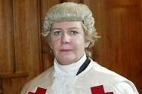
Evidence and Procedure Review
“ The best way to secure reliable evidence from a child or other vulnerable witness, in a manner that minimises any further harm to them, is to remove them as far as possible from the traditional styles of questioning and cross-examination.”
Lady Dorrian,
Evidence and Procedure Review
Notes:
The Scottish Court Service Evidence and Procedure Review and subsequent Next Steps report of February 2016 recognised many of the same issues, in relation to the experience of children and other vulnerable witnesses in the justice system.
In particular it’s conclusions and recommendations highlighted the:
Importance of the quality of the questioning in securing the best possible evidence from young or vulnerable witnesses,
and the
Need to improve the quality of facilities available for child and vulnerable witnesses, including the scope for the greater use of locations outwith Court premises.

Slide 12
Evidence and Procedure Review
“It is not merely a case of adapting the system we have, but of constructing a new approach, based on the wealth of scientific and experiential evidence available.”
Lady Dorrian,
Evidence and Procedure Review
Notes:
The review called for consideration to be given to the development of a new, structured scheme that treats child and vulnerable witnesses in an entirely different way, away from the court setting altogether.

Slide 13
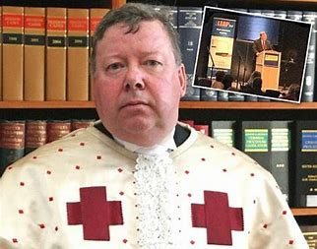
Can we make the vision happen?
“The trial as we know it today, will not involve any witnesses in court at all. In solemn procedure both evidence in chief and cross examination will be recorded at times convenient to everyone. The trial will consist of playing of evidence, speeches as usual and the judges direction. In summary cases evidence will also be pre-recorded, lawyers will turn up to make submissions and the Sheriff will reach a decision.
”Lord Carloway, 19 June 2016
Notes:
Has to be part of a bigger vision of transformation – but this wont happen without a big push from us!

Slide 14
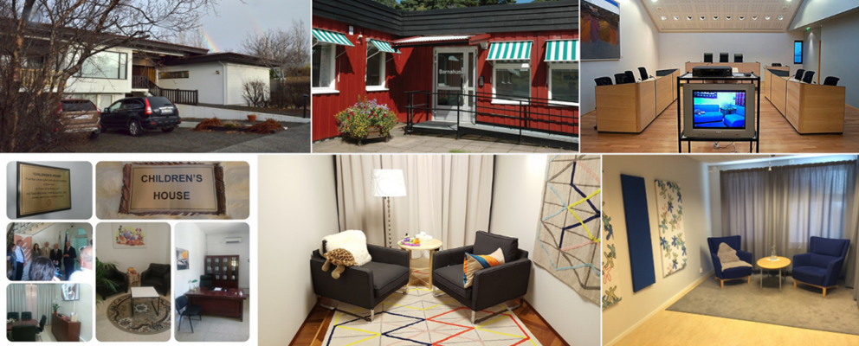
Bringing the European Barnahus model to Scotland
Notes:
Barnahus – European best practice in supporting child victims and witness

Slide 15
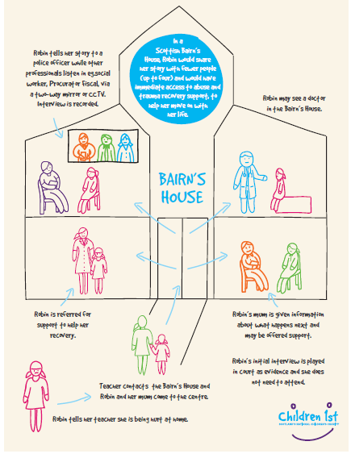
Time for a Bairn’s Hoose!
Not waiting
Not having to tell my story over & over
Help to recover
Not treating Mum like a criminal
More colourful,
comfortable seating,
better lighting & a different building
Everyone I need in one place
Notes:
What could Barnahus mean in Scotland – a Bairnshoose?
We need to think about how we can truly wrap systems, processes and approaches around children, rather than around organisational needs – and be ambitious in both short-term and long-term changes we’re going to make.
And we need to really listen to what children and young people say needs to change – so that no child feels in Isla’s words like “they were on trial” or in Tom’s that: “What happened afterwards (in court) was worse than the abuse itself.”

Slide 16
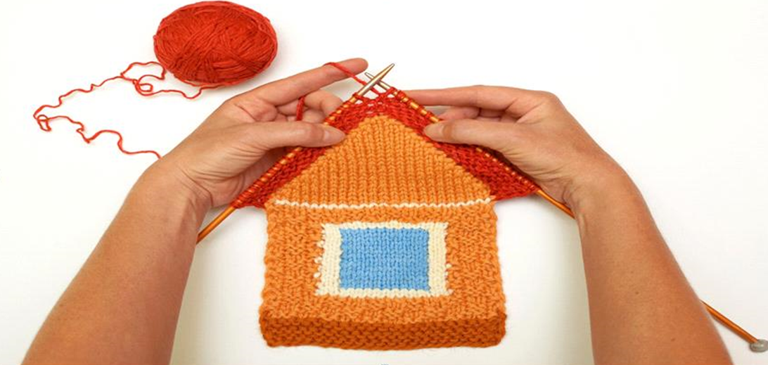
Young victims and witnesses experiences as drivers for change

Slide 17
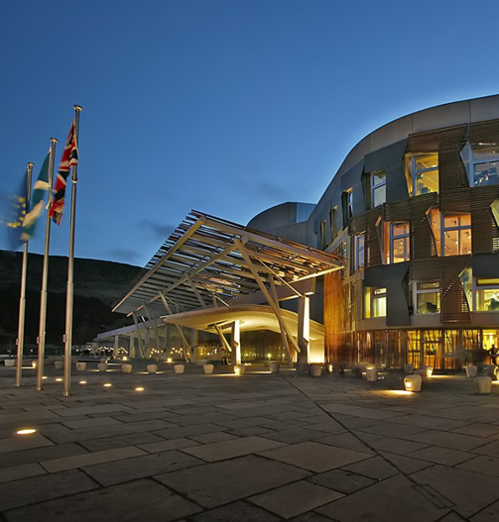
Next steps
Development of standards for Scotland lead by HIS & Care Inspectorate
Expert Advisory Group
Holyrood agenda after 2021 elections
Notes:
Next steps include
HCI/CI process to develop standards for Barnahus in scotland – should be consulted on in spring 2020, and agreed by June 2020
Expert advisory group promised to lead Scotland towards the preferred destining of Barnahus (can you mention your role?
Lots of interest from politicians of all parties – likely to feature heavily in 2021 manifestos

Slide 18
Closing thoughts

